Slide 1
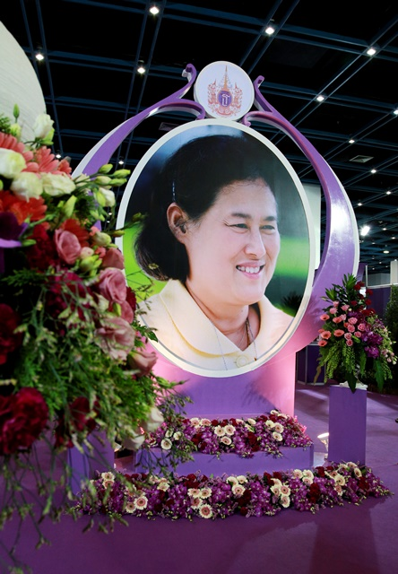
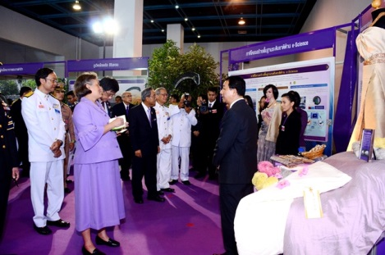
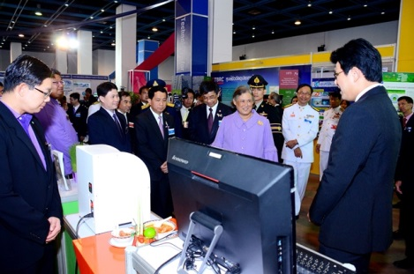
Royal Celebration at NAC 2015
Purple was the official color at Thailand Science Park this morning when staff and researchers of NSTDA and research agencies welcome HRH Princess Maha Chakri Sirindhorn who presided at the Royal Opening Ceremony of 2 scientific conferences. The first is a conference on HRH Princess Maha Chakri Sirindhorn’s S&T Initiative Projects which is marked as a Royal Celebration for HRH 60th Anniversary at Sirindhorn Science Home. The second is the NSTDA Annual Conference (NAC 2015) under the theme “Science, Technology and Innovation: Princess Sirindhorn's Initiatives for the Benefit of Thai Society” at TSP Conference Center. In addition, HRH also visited the royal exhibitions in her honour.
Both conferences and exhibitions is open to the public from March 31 – April 2 (09:00 – 17:00). To register, please log at http://www.nstda.or.th/nac2015/

