Slide 1
Introduction to the IOMC Toolbox for Decision-Making in Chemicals Management
The project is
implemented
by IOMC
The project is funded by
The European Union
June 2015

Slide 2
Inter-Organization Programme for the Sound Management of Chemicals (IOMC)
Established in 1995
Objective: To strengthen international cooperation in the field of chemicals and to increase the effectiveness of the organisations’ international chemicals programmes
The project is
implemented
by IOMC
The project is funded by
The European Union

Slide 3
Examples of activities:
SAICM:
QSPTF Implementation Committee
Assisting countries to implement projects
Participating in SAICM regional meetings and co‐organizing back‐to‐back workshops
Developing guidance for SAICM implementation/capacity building
Contributing to the implementation of SAICM activities on emerging issues
IOMC products
Joint activities
Inter‐Organization Coordinating Committee, WHO Secretariat
www.iomc.info
The project is
implemented
by IOMC
The project is funded by
The European Union

Slide 4
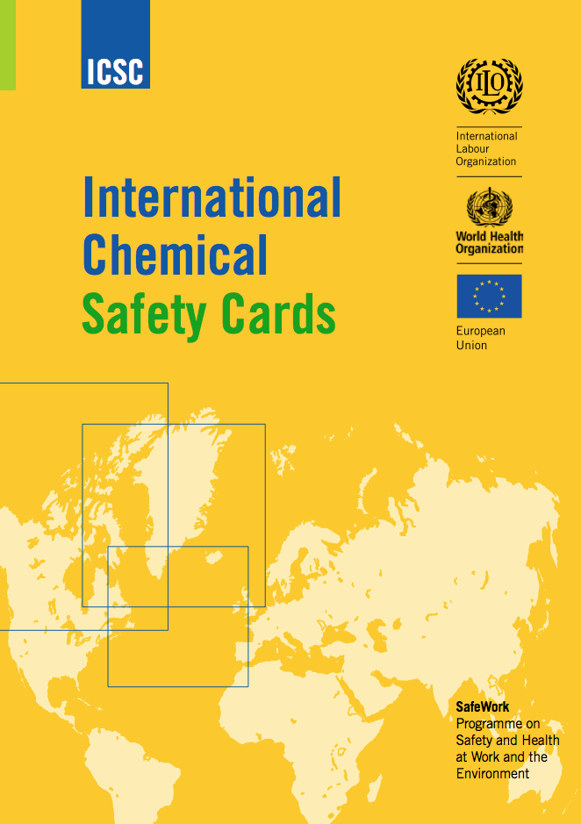
IOMC Toolbox: The Challenge
IOMC Participating Organizations have developed hundreds of tools and guidance documents that are relevant for countries in their efforts to implement SAICM
However, finding the most appropriate tool or guidance document to address specific national issues can be a challenge
The project is
implemented
by IOMC
The project is funded by
The European Union

Slide 5
IOMC Toolbox: The Solution
The internet-based IOMC Toolbox enables countries to identify the most relevant and efficient national chemicals management actions
The Toolbox takes into account the resources available and guides users towards cost-effective solutions adapted to the country
At each implementation step, the Toolbox presents the relevant IOMC resources, guidance documents, and training material, all available online and free of charge
The project is
implemented
by IOMC
The project is funded by
The European Union

Slide 6
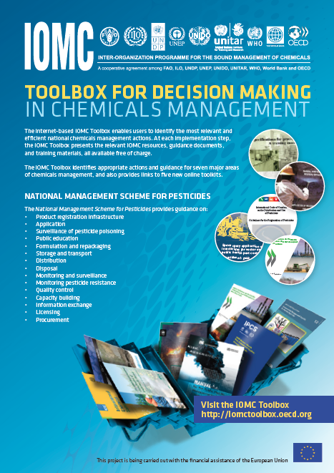
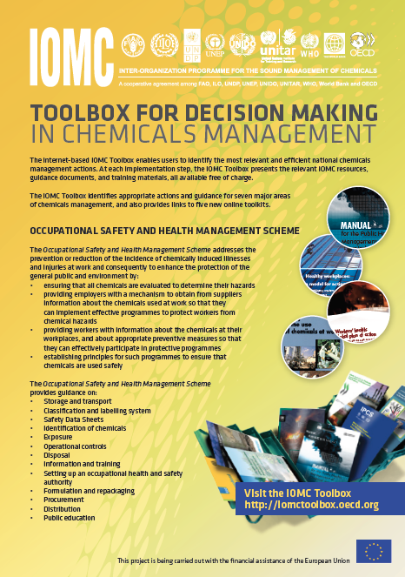
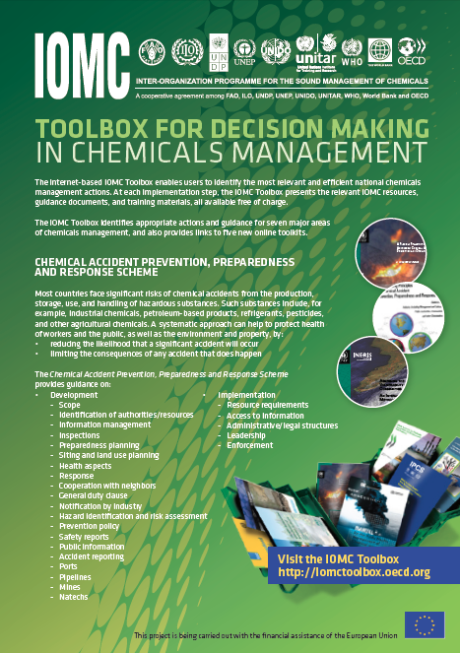
IOMC Toolbox: The Scope
The IOMC Toolbox identifies appropriate actions and guidance for:
A national management scheme for pesticides
An occupational health and safety system
A chemical accidents prevention, preparedness, and response system for major hazards

Slide 7
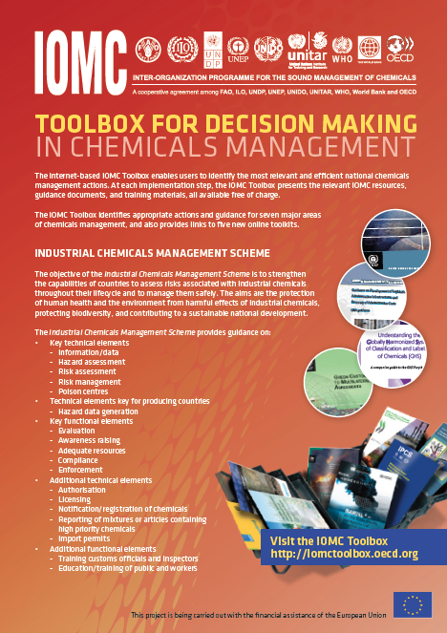
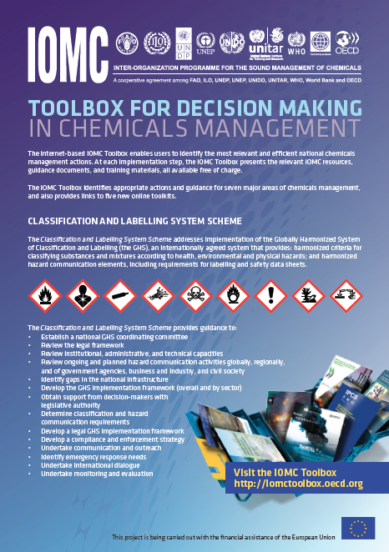
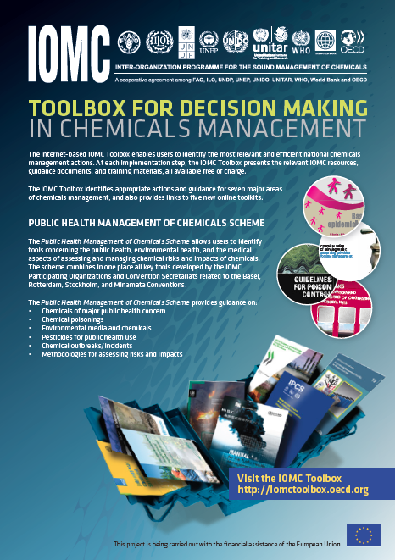
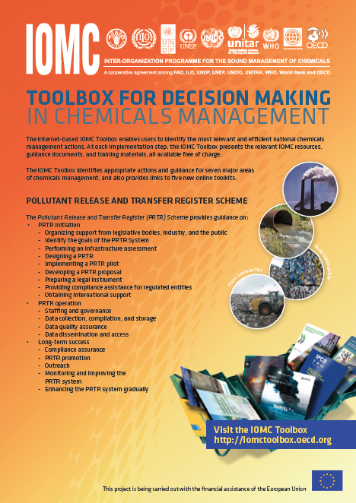
IOMC Toolbox: The Scope
An industrial chemicals management system (new!)
A classification and labeling system (new!)
A system to support health authorities which have a role in the public health management of chemicals (new!)
Pollutant release and transfer registers (coming soon!)

Slide 8
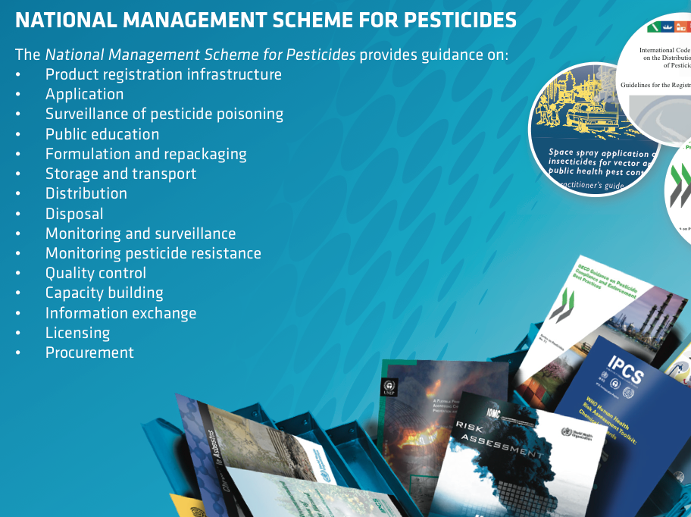
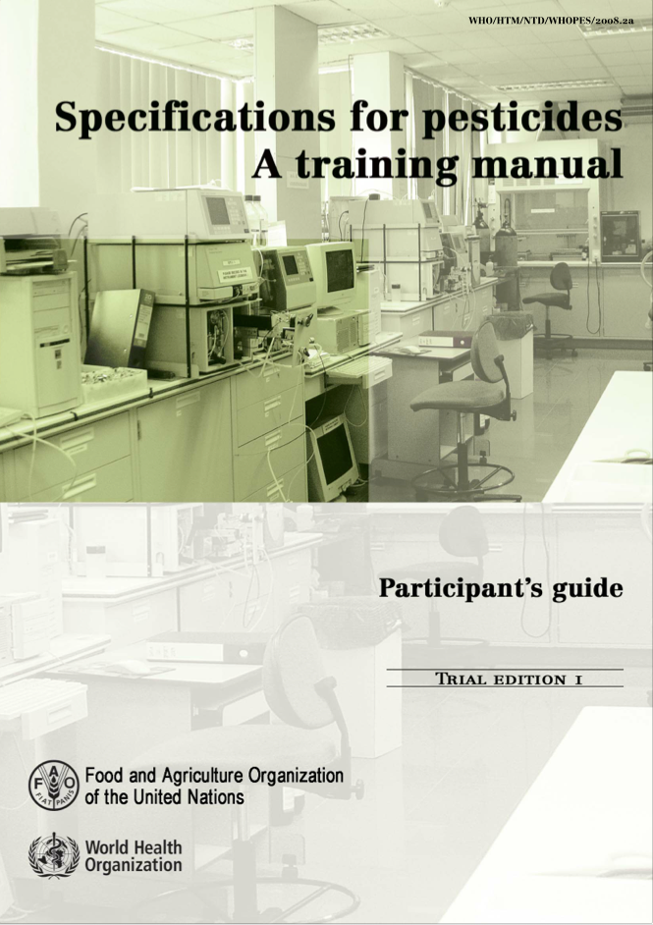
IOMC Toolbox Example: National Management Scheme for Pesticides
Provides guidance on:
Product registration infrastructure
Application
Surveillance of pesticide poisoning
Public education
Formulation and repackaging
Storage and transport
Distribution
Disposal
Monitoring and surveillance
Monitoring pesticide resistance
Quality control
Capacity building
Information exchange
Licensing
Procurement
The project is
implemented
by IOMC
The project is funded by
The European Union

Slide 9
IOMC Toolbox: The Scope
The IOMC Toolbox also provides links to five new online toolkits:
OECD Environmental Risk Assessment Toolkit
WHO Human Health Risk Assessment Toolkit
FAO Toolkit for Pesticides Registration Decision Making
UNIDO Toolkit on Innovative, Safe and Resource Efficient Application of Chemicals in Industry
UNIDO Toolkit on Chemical Leasing
The project is
implemented
by IOMC
The project is funded by
The European Union

Slide 13
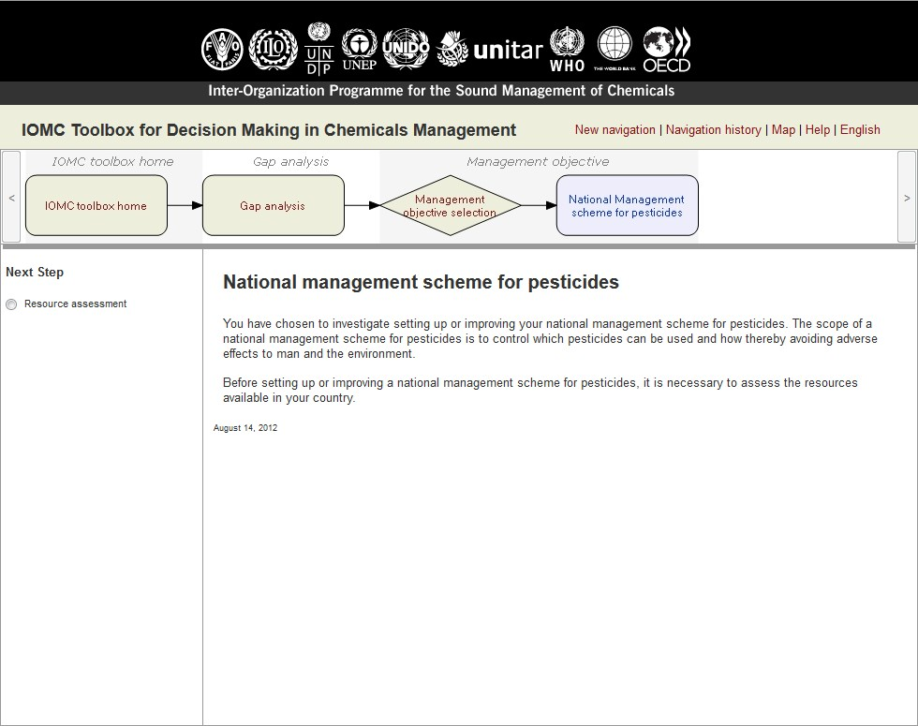

Slide 18
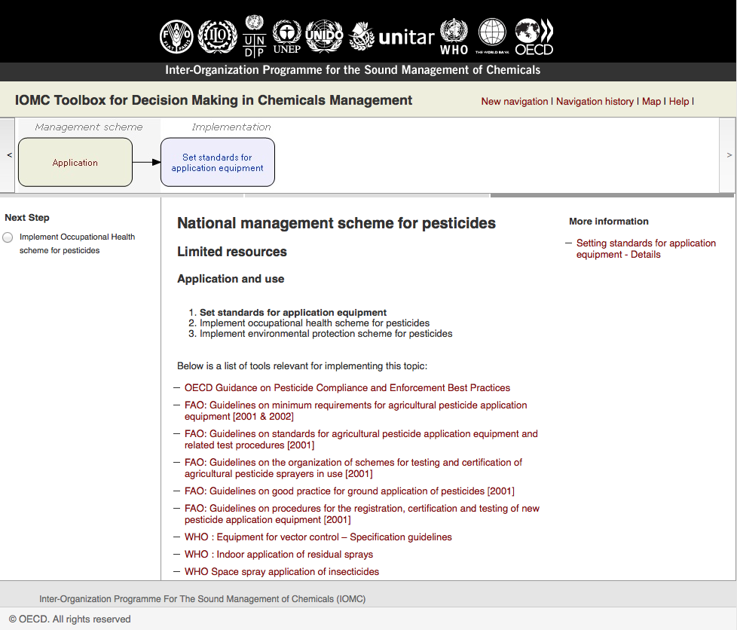

Slide 19
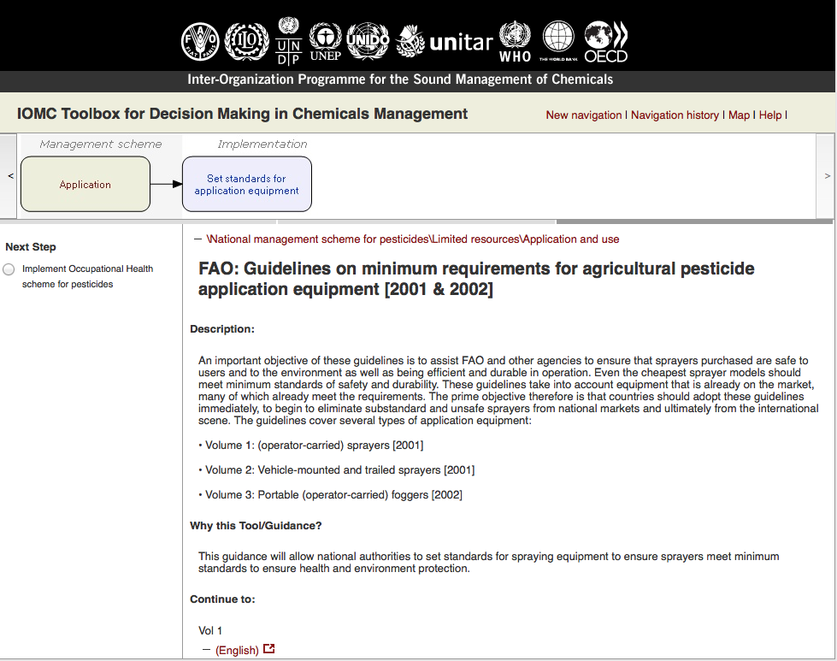

Slide 20
IOMC Toolbox: A Platform for Collaboration
The new version of the IOMC Toolbox provides a set of interactive features allowing governments to use it as a platform for collaboration among ministries, agencies, and other stakeholders such as industry
Users can save their information, add comments, and share and discuss issues with colleagues and partners
The project is
implemented
by IOMC
The project is funded by
The European Union

Slide 21
IOMC Toolbox: Webinars
Introduction to the IOMC Toolbox: Sept 2015
Industrial chemicals management scheme: Oct 2015
GHS scheme: Nov 2015
Pesticides scheme: Dec 2015
The project is
implemented
by IOMC
The project is funded by
The European Union

Slide 22
The project is
implemented
by IOMC
The project is funded by
The European Union

