Slide 1
OECD recommendation on The safety of
Nanomaterials
QualityNano Conference, 15-17 July, 2015, Heraklion, Crete

Slide 2



































OECD
Australia
Austria
Belgium
Canada
Czech
Republic
Chile
Denmark
Estonia
EC
IGOs
Non-member economies
Industry
Trade Unions
Environmental NGOs
Animal Welfare NGOs
France
Germany
Finland
Hungary
Iceland
Greece
Israel
Italy
Ireland
Korea
Luxembourg
Japan
Norway
Netherlands
Mexico
Poland
Portugal
NZ
Slovenia
Spain
Slovak
Republic
Switzerland
Turkey
Sweden
US
UK
Notes:
The OECD is an Intergovernmental organisation, which includes 34 member countries + European Commission
BIAC – TUAC- NGOs- Non-Members
The Organisation provides a setting where governments compare policy experiences, seek answers to common problems, identify good practice and coordinate domestic and international policies.

Slide 3
OECD’s Areas of Work on Nano
Testing and Assessment
Env. Sustainable Use of MN
Risk Assessment and Regulatory Framework
Exposure Measurement and Mitigation
Notes:
This group promotes international co-operation amongst countries on the human health and environmental safety aspects of manufactured nanomaterials for regulatory purposes, including legislative, voluntary or other management schemes.

Slide 4
OECD’s Work on Environment, Health and Safety
PROTECT
(man & environment)
EFFICIENCY
Harmonized policies and
Instruments of high
quality for
regulatory purposes
Work sharing
Avoid duplication
Avoid non-tariff trade barriers
shorten time to market
Notes:
Harmonisation (Mutual Acceptance of Data, Test Guidelines, Good Laboratory Practice)
Co-ordination/work sharing (Testing & Assessment)
Global convergence (Information & networking)
- all stakeholders
- non-member economies
Harmonised policies and instruments
Frameworks for worksharing
Minimisation of non-tariff trade barriers
Resource savings by avoiding duplication
Convergence of policies among member countries and non-member countries

Slide 5
OECD CHEMICALS
Good Laboratory Practice
Test Guidelines
Manufactured Nanomaterials
Hazard Assessment
Exposure Assessment
Pollutant Release and Transfer Registers
Pesticides
Biocides
Chemical Accidents
Biotechnology
Novel Foods and Feeds
JOINT MEETING
Chemicals Committee
OECD
Council
OECD
Secretariat
WP Chemicals, Pesticides & Biotechnology

Slide 6
Mutual Acceptance of Data (MAD)
Test
Guidelines
Good Laboratory
Practice
A single quality standard should be applied for testing of all chemical substances
A single quality standard for test facilities throughout OECD
Mutual Acceptance of Data
Legally binding on OECD Member countries
and other MAD Adherents
→Avoids duplication of testing: around Euros 150 million saved each year
→Reduces use of animals
→Reduces trade barriers
Notes:
DATA QUALITY ENSURED BY TG and GLP
Test Guidelines:
Approximately 150 Test Guidelines to determine the safety of chemicals and chemical preparations, including pesticides and industrial chemicals.
Physical-chemical properties
Human toxicity
Ecotoxicity
Bio-degradation and accumulation
Pesticide residue testing
Good Laboratory Practice:
Testing facility’s organisation and personnel, quality assurance programme, physical plant, apparatus, materials and reagents.
In order to govern principles, testing facilities should provide;
conditions for establishing and maintaining test systems;
standard operating procedures;
performance of the study;
reporting of results;
storage, retention and retrieval of records and materials etc.
Full Adherents to MAD
South Africa (since 2003)
Singapore (since 2010)
India (since 2011)
Brazil (since 2011)
Argentina (since 2011)
Malaysia
Provisional Adherent : Thailand

Slide 7
OECD COUNCIL RECOMMENDATION ON NANO: Endorsed on 19th September 2013
Existing Legal Frameworks are applicable (might need to be adapted)
Members, in the testing of manufactured nanomaterials, apply the OECD Test Guidelines, adapted as appropriate to take into account the specific properties of manufactured nanomaterials;
the OECD Principles of Good Laboratory Practice;
It is open to non-members.

Slide 8
TESTING AND ASSESSMENT OF MN
Fullerenes
SWCNTs
MWCNTs
Nano -Silver
Titanium dioxide
Cerium oxide
Zinc oxide
Silicon dioxide
Dendrimers
Nanoclays
Gold nanoparticles
TESTING MN:
International effort to share the testing of an agreed set of MN
selected by OECD
To review existing OECD TGs for adequacy
Phys-chem
biotic systems
degradation and accumulation
health effects
Guidance documents:
Guidance Manual for the Testing Programme
Sample Preparation and Dosimetry (GNSPD)
Notes:
Need to modify? New tests needed?
To develop appropriate test strategies for MN
To develop guidance for appropriate testing of MN
Noted that the work on the applicability of Test Guidelines and Guidance documents continues to be a corner stone of the WPMN.
This is the list of a representative set of MNs and leading country to test the MNs.
The Sponsorship Programme involved OECD member countries, as well as some non-member economies and other stakeholders. Through this program, we are pooling expertise and funding to test the human health and environmental safety effects of 11 nanomaterials that are currently in commerce.
We have received Dossiers on each nanomaterial addressed. However, we are still processing the information since it is not always in the same format. We expect to have Robust Studies Summaries.
Note:
The phrase “representative nanomaterials” was intended to mean those manufactured nanomaterials (MNs) now or soon to enter into commerce.
This is the list of a representative set of MNs and leading country to test the MNs.
The Sponsorship Programme involves OECD member countries, as well as some non-member economies and other stakeholders.
Through this program, we are pooling expertise and funding to test the human health and environmental safety effects of nanomaterials that are currently in commerce. You can mentioned that it is not only 11 nanomaterials but several nanomaterials of diferent size. For example, for TiO2 they tested 5 different nanomaterials (based on size and application –cosmetic, food, other).

Slide 9
List of Endpoints Addressed by the OECD Testing Programme
Nanomaterial Information/Identification (9 endpoints) substance name, chemical identity, uses, coating
Physical-Chemical Properties and Material Characterization (17 endpoints) water solubility, particle size, agglomeration/aggregation
Environmental Fate (15 endpoints) biodegradability, adsorption, accumulation
Environmental Toxicology (6 endpoints) effects on aquatic and terrestrial organisms
Mammalian Toxicology (9 endpoints) inhalative toxicity, reproductive toxicity, genotoxicity
Material Safety (3 endpoints) flammability
Notes:
Just the list of endpoints addressed. Perhaps to reiterate that the objective of the programme was to test the TG rather than focusing on the inherent properties of each nano. So at the end, we care less about the result of the test than of the applicability of the method.

Slide 10
TESTING AND ASSESSMENT
WORK UNDERWAY
Identify TG/GD needs
Communicate the results of the Testing Programme
Assessment of the Data: Lessons Learned/ Read Across
Notes:
Identify further TG/GD needs/ Read Across:
Inhalation Toxicity (2011, Netherlands)
Environmental fate and eco-toxicity (2013, Germany)
Physical-chemical properties (2013, Mexico)
Nano genotoxicity (2013, Canada)
Toxicokinetics (2014, Korea- leaded by Germany)
Categorisation (2014, USA)
Results from the Testing Programme:
Raw Data, Lessons Learned: 1 Dossier including the information in a IULCLID style printed form/ harmonised the presentation of the data/
Assessment of the Data:
Physical-Chemical Assessment: to be presented in February 2015. Analysis and recommendations.
Toxicological and Eco-toxicological : outsource to other OECD bodies

Slide 11
TG/ GD under revision
Amendments to the Inhalation TG and GD to Accommodate NM
GD on Aquatic (and Sediment) Toxicology Testing of NM
TG for the Dissolution Rate of Nanomaterials in the Aquatic Environment
GD for Dispersion and Dissolution of NM in Aquatic Media – Decision Tree
GD on Assessing the Apparent Accumulation Potential of NM
TG for Dispersibility and Dispersion Behaviour of NM in Aquatic Media
(new) TG for Nanomaterial Removal from Wastewater
GD on the Adaptation of In Vitro Mammalian Cell Based Genotoxicity TGs for Testing of Manufactured Nanomaterials

Slide 12
RESULTS OF THE TESTING PROGRAMME: DOSSIERS
The Nanomaterials were chosen to assess the applicability and accuracy of existing test guidelines and to identify where technical adaptation were needed. It was not intended conclude on risks associated with the use or application of nanomaterials.
Cerium oxide Dendrimers Fullerenes (C60) Multi-walled carbon nanotubes (MWCNTs) Single-walled carbon nanotubes (SWCNTs) | Nanoclays Silicon dioxide Silver nanoparticles Titanium dioxide Zinc oxide Gold nanoparticles

Slide 13
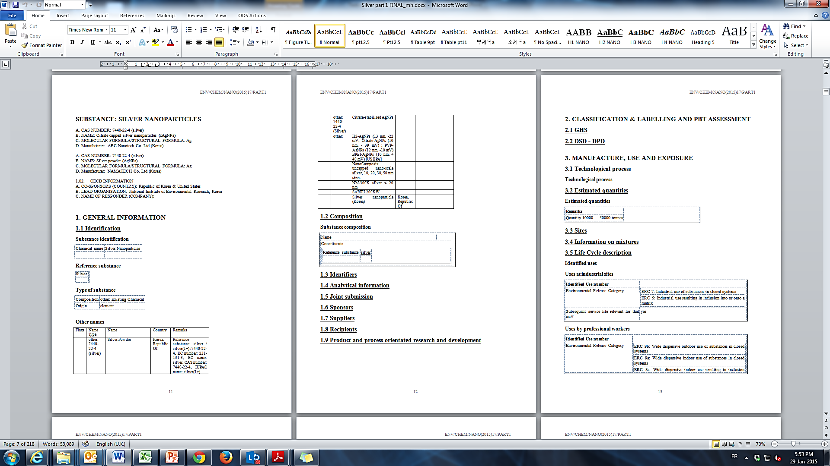
Dossiers in a IUCLID style printed form
Notes:
The documents have the same endpoints than the IUCLID software.

Slide 14
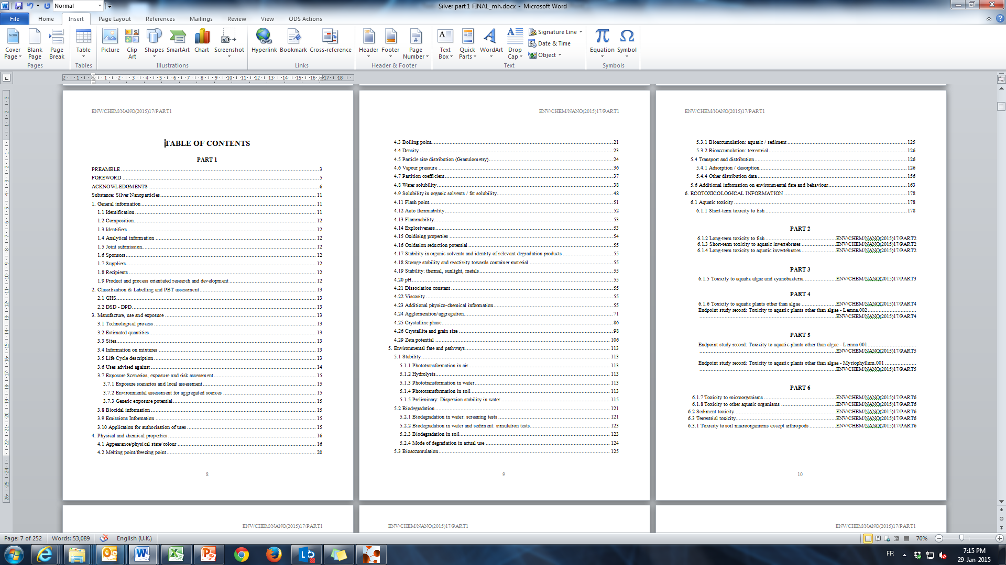
Table of Contents Example: Silver part 1

Slide 15
Assessment of submitted physchem data from the testing programme
test method used?
adaptions
dispersion method was used?
Is the test method suitable and sufficient (this/ other nanos)
Is the test method suitable and sufficient for other (group(s) of) nanomaterials?
recommendations for adaptations of the test method included in the dossier?
Expert opinion on the validity of the method

Slide 16
Results of method evaluation
For most evaluated parameters, one or more methods were found suitable for testing nanomaterials:
Methods suitable for (almost) all NMs, available to measure Aggregation/Agglomeration, Crystalline phase, Dustiness, Chemical composition, Radical formation potential
Methods limited to specifc types of NM / specific conditions, available to measure Specific surface area, Zeta potential, Photocatalytic activity, Porosity
No suitable methods available (in this evaluation) for Particle size distribution, Redox potential
Notes:
25 different methods evaluated
●No OECD guidelines were used
●Mainly methods from scientific literature, plus 5 standardized methods (4x ISO, 1x NEN)
Inductively coupled plasma optical emission spectrometry (ICP-OES)
Energy Dispersive X-ray (EDX / EDS)
X-Ray Diffraction (XRD)
Transmission Electron Microscopy (TEM)
Scanning Electron Microscopy (SEM)
Dynamic Light Scattering (DLS)
Electrophoretic Light Scattering (ELS)
Laser-Doppler
(Small) Rotating drum
Continuous drop dustiness tester
Vortex shaker
Degradation tests (Rhodamine-B, DPPH, Hydroxyl radical generation, Orange II, acetaldehyde)
Mercury porosimetry
Gas absorption (Brunauer-Emmett-Teller - BET)
Gas absorption (Barrett-Joyner-Halenda - BJH)
Electron paramagnetic resonance (EPR)
Electron spin resonance (ESR)
Benzoic acid PBS method (HPLC)
Potassium iodide and optical absorbance
Potentiometry
OxoDish O2-detection

Slide 17
WORK UNDERWAY
1. Assessment of the quality and relevance of data in the context of hazard characterization.
2. Based on this exercise evaluate if it is possible to continue with integrated approaches to testing strategies, broader risk assessment for MN which may including grouping/category and read-across approaches

Slide 18
OECD’s Areas of Work on Nano
Testing and Assessment
Env. Sustainable Use of MN
Risk Assessment and Regulatory Framework
Exposure Measurement and Mitigation
Notes:
This group promotes international co-operation amongst countries on the human health and environmental safety aspects of manufactured nanomaterials for regulatory purposes, including legislative, voluntary or other management schemes.

Slide 19
Risk Assessment and Regulatory Framework
To identified uncertainties in risk assessment when extrapolating from conventional chemical frameworks to manufactured nanomaterials [see ENV/JM/MONO(2012)8]
Prioritize gaps in risk assessment [ENV/JM/MONO/2013(2013)18]
Regulated Nanomaterials [published as ENV/JM/MONO(2014)28]
Notes:
To inform the gaps identified:
Directly informs on short-term needs to address ongoing risk assessments of MN and focuses medium and long-term priorities
Projects provide guidance on what risk assessors can do now and provide insights into what needs to be done for the ideal approach
Focus on:
regulatory updates from jurisdictions;
definitions for nanomaterials; and
challenges jurisdictions are facing with respect to regulating nanomaterials in their respective countries.

Slide 21

Env. Sustainable Use of MN
Nanotechnology and Tyres:
Greening Industry and Transport
The report emphasizes the importance of:
The policies to support research in the environmental, health and safety risks, as well as those to support the commercialisation of nanotechnology research results, for fostering responsible innovation in the tyre sector;
Using available tools (e.g. cost/benefit analysis, LCA) to gain better insight into the socio-economic and environmental impacts of nanotechnology applications;
Collaboration between governments and industry to address the specific challenges raised by the introduction of new nanomaterials in different industry sectors.
Notes:
This project focus on the Life cycle Assessment of Nanomaterials. The most recent publication was done on Nanotechnology used in Tyres.

Slide 22
Contact / Information/ Publications
THANK YOU! OECD Secretariat
peter.kearns@oecd.org
mar.gonzalez@oecd.org
terumi.munekane@oecd.org
hoseok.song@oecd.org
jihane.elgaouzi@oecd.org
nanosafety@oecd.org
Publications free to download
www.oecd.org/env/nanosafety
Results from the testing programme
http://www.oecd.org/chemicalsafety/nanosafety/testing-programme-manufactured-nanomaterials.htm
Notes:
A

