Slide 1

Ministry of Science, Technology and Innovation
National Nanotechnology Policy, Strategy and programs: National Nanotechnology Safety & Regulatory Program 2016-2020
DR. Abdul Kadir Masrom
Under Secretary
National Nanotechnology Directorate
Ministry of Science, Technology and Innovation (MOSTI)
Email: akadir@mosti.gov.my
The Ministry of Science, Technology and Innovation

Slide 2
NATIONAL NANOTECHNOLOGY DIRECTORATE (NND)
To develop national capability and capacity through the development of policies, infrastructure and facilities,
To boost human capital in the field;
To plan and coordinate development of NT-based industries
Education and public awareness programmes
Building capacity and R&D facilities
Health, safety and environmental initiatives
NNP
NMB
NNC
Mandates

Slide 3
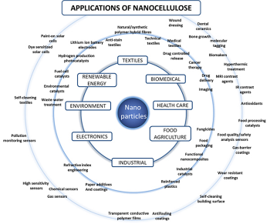
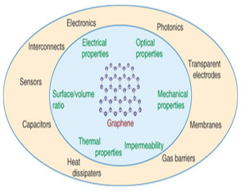
Nano Safety & Regulatory Program
National Graphene Action Plan 2014-2020
2016-2020
National Nanotechnology
Policy and Strategy
Nanotechnology Strategic Thrust Areas for 11th Malaysia Plan (2016-2020)
Long Term Research Strategy for 11th Malaysia Plan (2016-2020) for Graphene and Nanocellulose
NANOCELLULOSE
GRAPHENE
Road Mapping 2020 and Beyond

Slide 4



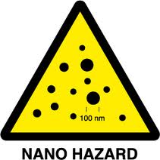

Strategic Thrust 3: Promoting Sustainable and Responsible NT Development
P2: Nanotechnology Safety, Health and Environment Regulatory Development & Certification
P3: Nanotechnology Professional , and Product Certifications
P4: Nanotechnology SHE Risk Awareness
P1: Nanotechnology Public Awareness

Slide 5
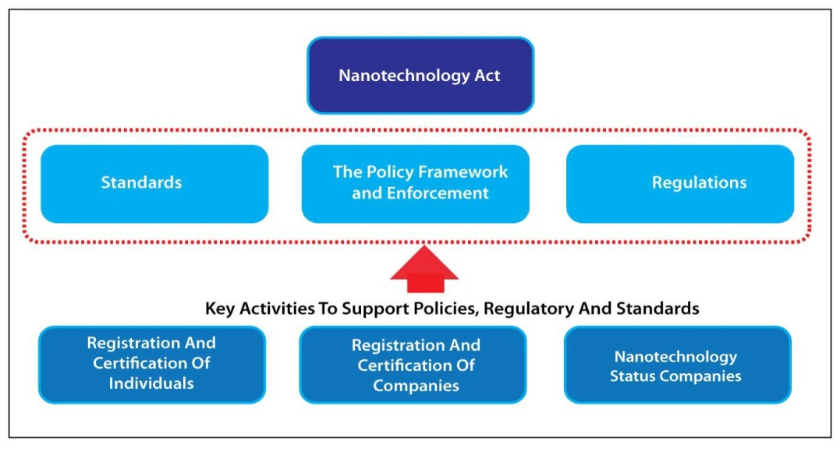
CHAPTER 10: Regulation and Safety
SUGGESTED NANOTECHNOLOGY REGULATORY FRAMEWORK
National Nanotechnology Implementation Council
National Nanotechnology Regulatory and Safety Committee
National Nanotechnology Regulatory and Safety Enforcement Coordination Unit
Management of Nanotechnology Regulation and Safety

Slide 6
2016-2020
Program: Development of Safety and Risk Level Determination of Nanotechnology Products.
National Nanotechnology Directorate

Slide 7
Background
Ensuring the safe developments and applications of nanotechnology have been one of the major National Nanotechnology Directorate activities. The main emphasis of the proposed program is on impact assessment of engineered nanomaterials and nano products on the safety of workers, consumers and environment that are relevant to Malaysian industries.

Slide 8
ENM safety issues are the key that hold the success of nano products and nanotechnology based industry – without consumers/people confidence, NT industry has no future

Slide 9
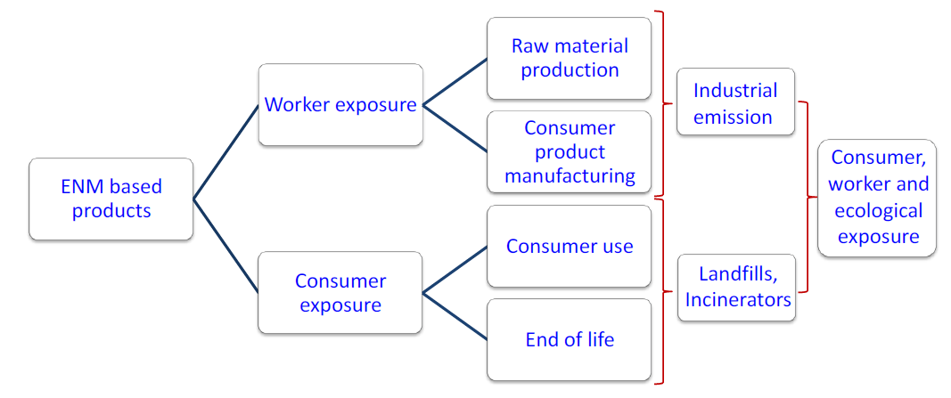
Human and environmental exposure paradigm of ENMs

Slide 10
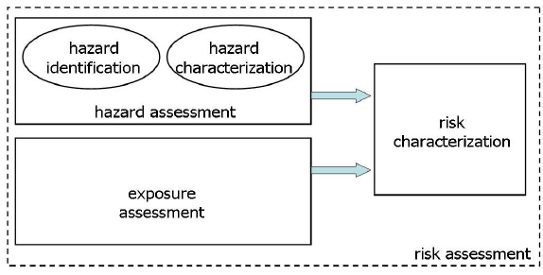
Elements of a chemical risk assessment
Elements of a chemical risk assessment (developed from OECD, 2003).

Slide 11
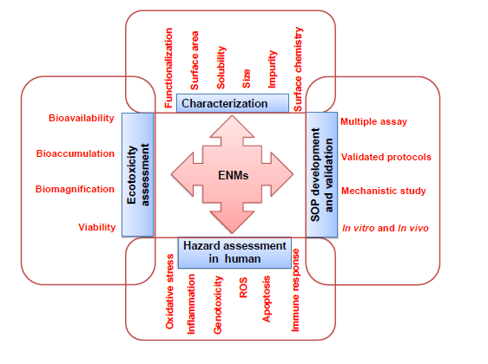
Multipronged approach for hazard identification of engineered nanomaterials

Slide 12
National Nano Safety Program
2016-2020
Dissemination
ISO TC229/ Stakeholder engagement Newsletters/websites/seminar
P1-Materials
Synthesis, Dispersion & Characterisation
P2 – Hazard
Toxicology
Ecotoxicology
P3 – Exposure1
Products/LCA (embedded ENM)
Fate/Behaviour
P3A-Exposure2
Workplace
Environmental
P4 – Risk
Workplace
Consumer
Environment
National Database
Assesment
Apprisal
Control & reduction

Slide 13
Program Aims
The aim of the program is to establish a program at national level to assist industry and researchers in carrying out their activities in developing nanotechnology safely and to enhance the confidence of the society in accepting nano products.
Study on implication of ENM on workers, consumers and environment.
Provide platform for local researchers to joint the international effort through research collaboration involving safety of ENM and contribute toward management of nano safety at international level.

Slide 14
The program will help academic community, researchers and industrial community to evaluate and control the risk involving their workers, consumers, public and environment through active research and dissemination of information.

Slide 15
Output
Database on the risk assessment and information on the nanoparticales that present in the products
HCD and Experts in area of nanosafety and risk assesment.

Slide 16
Expected Outcomes
Increased in nano products commercialisation - creation of new job opportunities
Safer environment for workers and public – sustainable industry
Increased public awareness on the benefits of nanotechnology products – greater acceptance and demand.
Product and process certifications - increased the product value and fulfilling the international standard criteria for exports

Slide 17
KPI
Performing 25 studies on ENMs and products peryear
Database on the safety information and risk assessment on ENMS and products
5 scientists in the field of nano safety and risk assessment per year

Slide 18
LIST OF REPRESENTATIVE MANUFACTURED NANOMATERIALS FOR TESTING
Nanomaterials
  Fullerenes (C60)
  Graphene
  Nano Cellulose
  Single-walled carbon nanotubes (SWCNTs)
  Multi-walled carbon nanotubes (MWCNTs)
  Silver nanoparticles
  Iron nanoparticles
  Titanium dioxide
  Aluminium oxide
  Cerium oxide
  Zinc oxide
  Silicon dioxide
  Dendrimers
  Nanoclays
  Gold nanoparticles

Slide 19
Thank You

