Slide 1
Nanostandardization and Nanosafety Program and
Activities in Iran
Ali Beitollahi
Director of International Collaboration and Nanostandardization Committees
Iran Nanotechnology Initiative Council (INIC)

Slide 2
Content of my talk
1- Brief Introduction of INIC.
2- Nanostandardization and Nanosafety Activities and Achievements.
3- Nanosafety Network
4- NanoMark Scheme
5- Future Plan.

Slide 3
The Role of INIC
Affiliated with
  Vice Presidency for Science and Technology
INIC is an organization responsible for:
  Policy Making;
  Public Awareness;
  Supporting Nanotechnology Development;
  Evaluation of Activities and Achievements

Slide 4
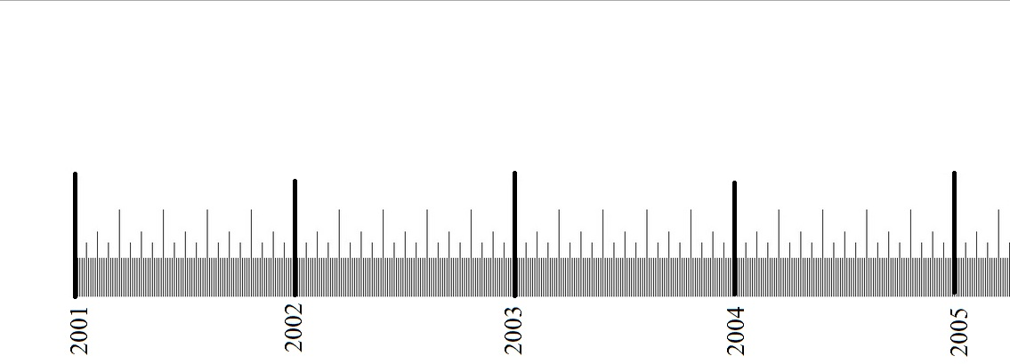
Background History of INIC
Nanotechnology Policy Studies
Cabinet passed NT
Program
2001
2003
2005
Establishment of INIC

Slide 5

President Deputy in Science and Technology
INIC Board of Trustees
Secretary General
INIC Coordination Board
Commercialization Development
Industrial Development
Tech-Market Services Corridor
Technology Development
Head of Secretariat
International Cooperation
Human Resources Development
Science and Technology Infrastructures
Public Awareness

Slide 6

Time Frames of the Future Strategy
کوتاه مدت
First
Second
Third
3 years
3 years
4 years
2006-2008
2009-2011
2012-2015
Second 10 years
2016-2025

Slide 7

  Creation of Wealth
  Raising People’s Quality of Life

Slide 8
































Graduate Training Programs
37 Universities Engaged in M.Sc. Programs,
17 Universities Running Ph.D. Programs
  Nano: Chemical Engineering, Medicine, Chemistry, Physics, Polymer, Biotechnology

Slide 9
Supported Research
Thesis
  PhD: More than 3000
  MSc: More than 13100
Centers
  More than 90 Universities and Research Institutes
Experts
  More than 24000 Experts
  More than 2200 Faculty Members

Slide 10
ISI Publication

Slide 11
No. of ISI Articles (2014) (Ref. Statnano.com)
Rank | Country | Number | Share (%) | Rank | Country | Number | Share (%)
1 | China | 41147 | 32.11 | 16 | Singapore | 2299 | 1.79
2 | USA | 22260 | 17.37 | 17 | Brazil | 2062 | 1.61
3 | India | 9329 | 7.28 | 18 | Poland | 1928 | 1.5
4 | South Korea | 8237 | 6.43 | 19 | Saudi Arabia | 1763 | 1.38
5 | Germany | 7845 | 6.12 | 20 | Switzerland | 1706 | 1.33
6 | Japan | 7252 | 5.66 | 21 | Turkey | 1578 | 1.23
7 | Iran | 5493 | 4.29 | 22 | Sweden | 1542 | 1.2
8 | France | 5211 | 4.07 | 23 | Malaysia | 1480 | 1.15
9 | UK | 4349 | 3.39 | 24 | Netherlands | 1465 | 1.14
10 | Spain | 3890 | 3.04 | 25 | Belgium | 1211 | 0.95
11 | Italy | 3733 | 2.91 | 26 | Egypt | 1110 | 0.87
12 | Russia | 3508 | 2.74 | 27 | Mexico | 1038 | 0.81
13 | Taiwan | 3397 | 2.65 | 28 | Czech Republic | 914 | 0.71
14 | Australia | 3052 | 2.38 | 29 | Portugal | 910 | 0.71
15 | Canada | 2912 | 2.27 | 30 | Finland | 858 | 0.67

Slide 12
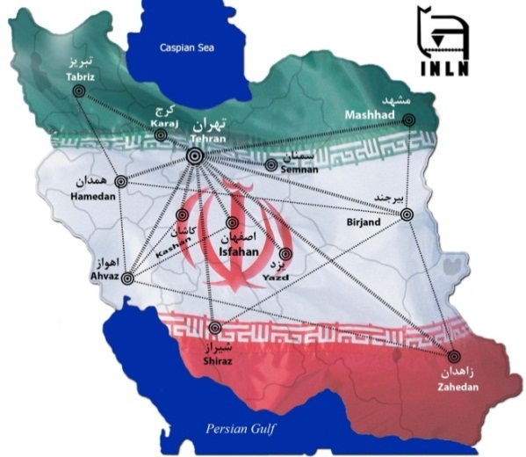
IRAN Nanotechnology Laboratory Network
(INLN)
1097 equipment from
70 research centers throughout IRAN

Slide 13
Start-up Companies: 109

Slide 14
Manufacturing Companies: 152

Slide 15
Nano Products: 274

Slide 16
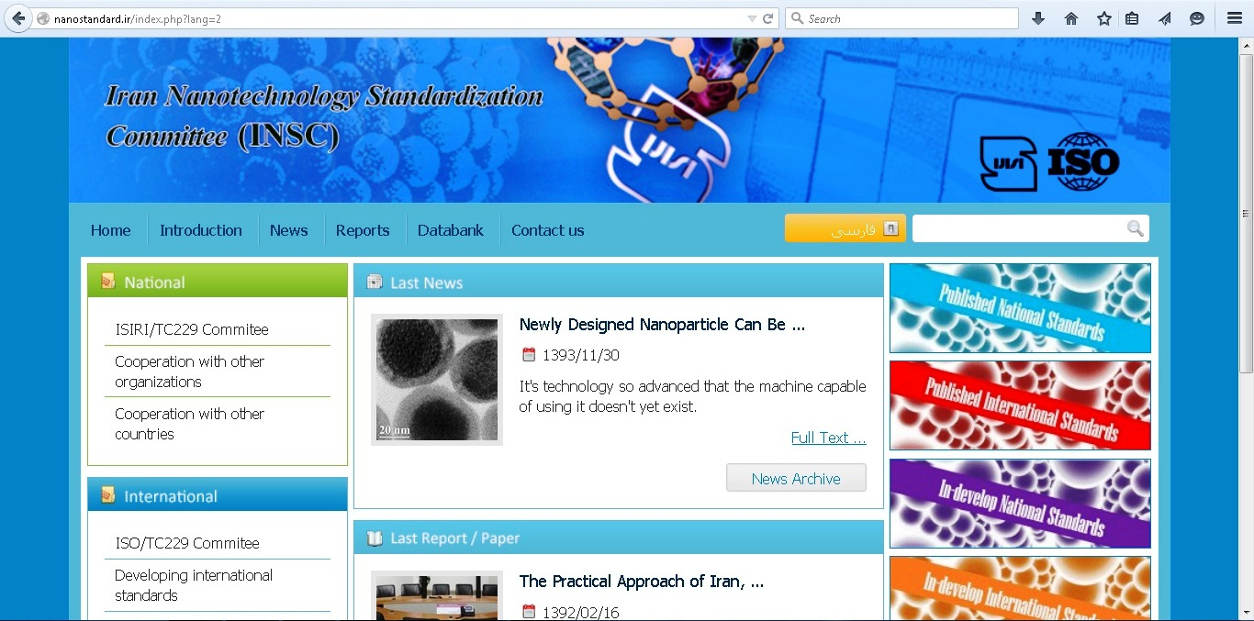
Iran activities in nanotechnology standardization
ISIRI/TC 229 mirror committee for nanostandardization was established by INIC with cooperation of ISIRI (Institute of Standard & Industrial Research of Iran) on December 2006 (3 working groups).
50 experts; From Universities, various industries, Research Centers, ministry of health, ministry of agriculture and ISIRI.

Slide 17
Iran activities in nanotechnology standardization
Currently Published 32 national standards in the fields of nanosafety, environment, measurements and terminology another 10 under way.
Iran was project leader of 3 ISO/TC229 standards:
  1- ISO/TR 11360
  Nanotechnologies –Methodology for the Classification and Categorization of Nanomaterials (Published).
  2- ISO/TS 16665
  -Nanotechnologies-Determination of muramic acid as a biomarker for silver nanoparticles activity (Published).
  3-ISO/TS 11810
  -Nanotechnologies: Vocabularies for Science, Technology and Innovation indicators (In publish Process).
  4- One Iran –Korea Joint NWIP (recently approved) and another 2 NWIP under ballot process

Slide 18
Iran activities in nanotechnology standardization
Establishment of a committee in Iran Food and Drug Agency (Iran Nano FDA) since 2008.
( products including Cosmetic, pharmaceuticals, healthcare and medical devices which are in the field of Nanotechnology need to get certificates form this committee for going to market.)
Establishing standard Committee in Ministry of Agriculture.
Designing comprehensive database for nanotechnology standards and safety.
National research grant program for master and PhD thesis related to nanotechnology standardization and safety issues.

Slide 19
Iran activities in nanotechnology standardization
Holding several national workshop and seminars for companies, students and researchers:
1- Methods for drafting and developing national, international and company standards.
2- Nanomaterial risk assessment.
3- Safety standards and protocols for nanomedicine products.
4- National seminar for nanotechnology standards and safety.
5- Standard characterization methods for nanomaterials.
6- Health and Safety in nano-occupational setting-code of practices.
7- Health and safety guideline for nanotechnology laboratories.

Slide 20
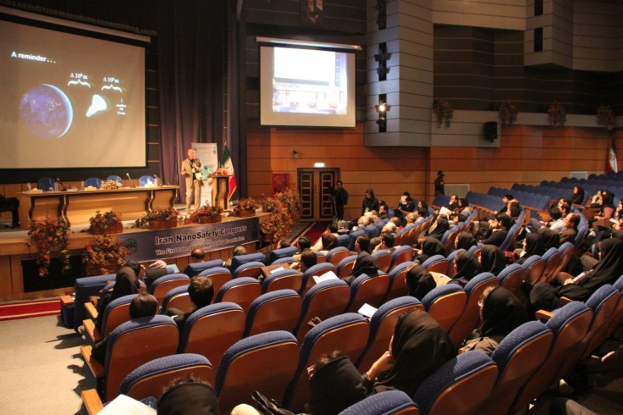
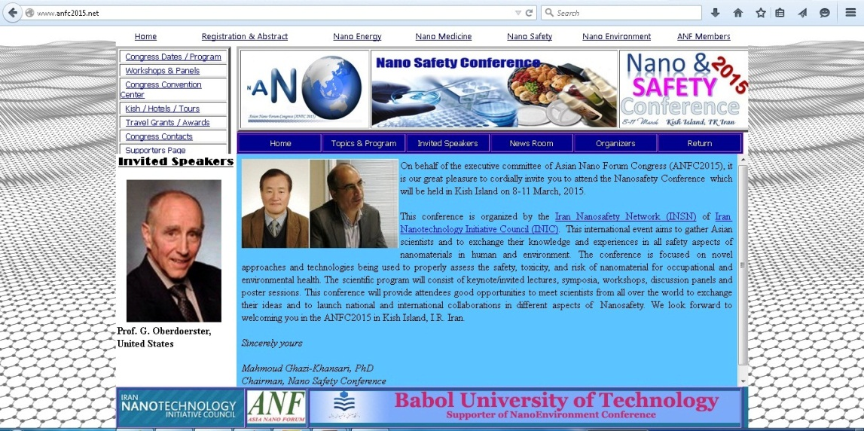
Iran activities in nanotechnology standardization (Conferences &Workshop)
International Nanosafety Congress (Tehran University of Medical Sciences, March 2015, Tehran) (Feb. 2014,).
ANFC 2015 Conference on Nanosafety ( Kish Island, March 2015).
Workshop on Inhalation Toxicity of Nanoparticles (Tehran University of Medical Sciences, March 2015, Tehran).

Slide 21
Iran Nanosafety Network
Established in 2012
Aims:
Networking researchers, experts, research institutes and industrial unites active in the field of EHS
Determining national priorities in direction with mission of nanosafety network and implementing these priorities with cooperation of other related national organization and centers.
Drafting national and international standards, Guidelines and Regulation in the filed of nano EHS.

Slide 22
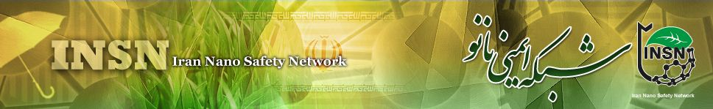
INSN Structure
INSN
Chairman of INSN
secretariat
Strategic committee
Occupational safety
WG
Human Health
WG
Environmental Health
WG
Nanoethics
WG

Slide 23
Iran Nanosafety network
Environmental Health WG; Scope and Focus:
Scope of this WG includes; Drafting standards, regulations and guidelines for environment and agriculture in the filed of nanotech.
Some of the main areas of focus:
life cycle analysis of nanomaterials.
Fate of nanomaterials in environment.
Factors affecting the transfer of nanomaterial in environment.
Environmental conditions for transfer of nanomaterials.
Risk management.
Effects of nanomaterials on ecosystems.

Slide 24
Iran Nanosafety network
Occupational Safety WG; Scope and Focus
Scope of this WG includes: Human resources training, drafting the relevant standards and protocols.
Some of the main areas of focus:
Assessing processes and factors affecting the level of exposure.
Identifying the groups who can be exposed to nanomaterials.
Studying the effects of exposure with different types of nanomaterials.
Surveying risk and hazard evaluation, exposure assessment and designing models and methods for risk assessment of nanomaterials.
Identifying the methods of control of the level of exposure to nanomaterials in deferent groups and medium.

Slide 25
Iran Nanosafety network
Human Health WG; Scope and Focus
Scope of this WG includes: Drafting standards, regulations and guidelines for safety and health related issues of naoproducts in the filed of foods, cosmetic, drugs, healthcare , medical devices and instruments.
Some of the main areas of focus:
In vivo effects of nanomaterials in human.
Characterization and measurement of nanomaterials in biological media.
Effect of physico-chemical parameters on toxcity.
How the human body responses to namaterials in molecular scale.
Effect of nanomaterials on human health in different life stages.

Slide 26
Iran Nanosafety network
Nanoethics WG; Scope and Focus
Scope of this WG includes: Developing guidelines, regulations, codes of conducts and related law to support sustainable and responsible development of nanotech.
Main Areas of Focus:
Studying the ethical, legal and social aspects of nanotech and related red lines.

Slide 27
Nanomark Scheme
Aims
To foster consumer trust and confidence.
To boost market development.
To Facilitate marketing and trade.

Slide 28
Advantages
Supporting sustainable growth of nano market.
Improvement of the quality of the products
Preventing frauds and misleading consumers.
Detecting local nanoproduct manufacturers and importers..
Implementing labeling regulations.
28

Slide 29
Nanomark scheme
Efficacy and Durability
Nanoscale
Nanomark Scheme
labeling
safety

Slide 30
Nanomark Committee Structure
Property/Specifications assessment
Institute of Standard
Iran Nanosafety
Network
Nanolab network
Nanoscale Audit
Nanomark
Ministry of
Agriculture
Tech-Market service corridor
Nano Standard Committee
Department of
Environment
Customs
Ministry of Health

Slide 31
Some of the Future Program
1- The development of more than 300 national nanostandards.
2- Increased contribution to ISO/TC229 standards.
3- Implementing Nanomark scheme for both nationally produced and imported nanoproducts as a mandatory step in future.
4- Reinforcing regional and international collaborations for developing nanostandards, regulations and protocols related to nanosafety.
5- Supporting the development and commercialization of RM by Iranian institutes and companies.
6-The development of national nanometerology initiative (currently under way) and establishment of Iran Nanometerology central institute

Slide 32
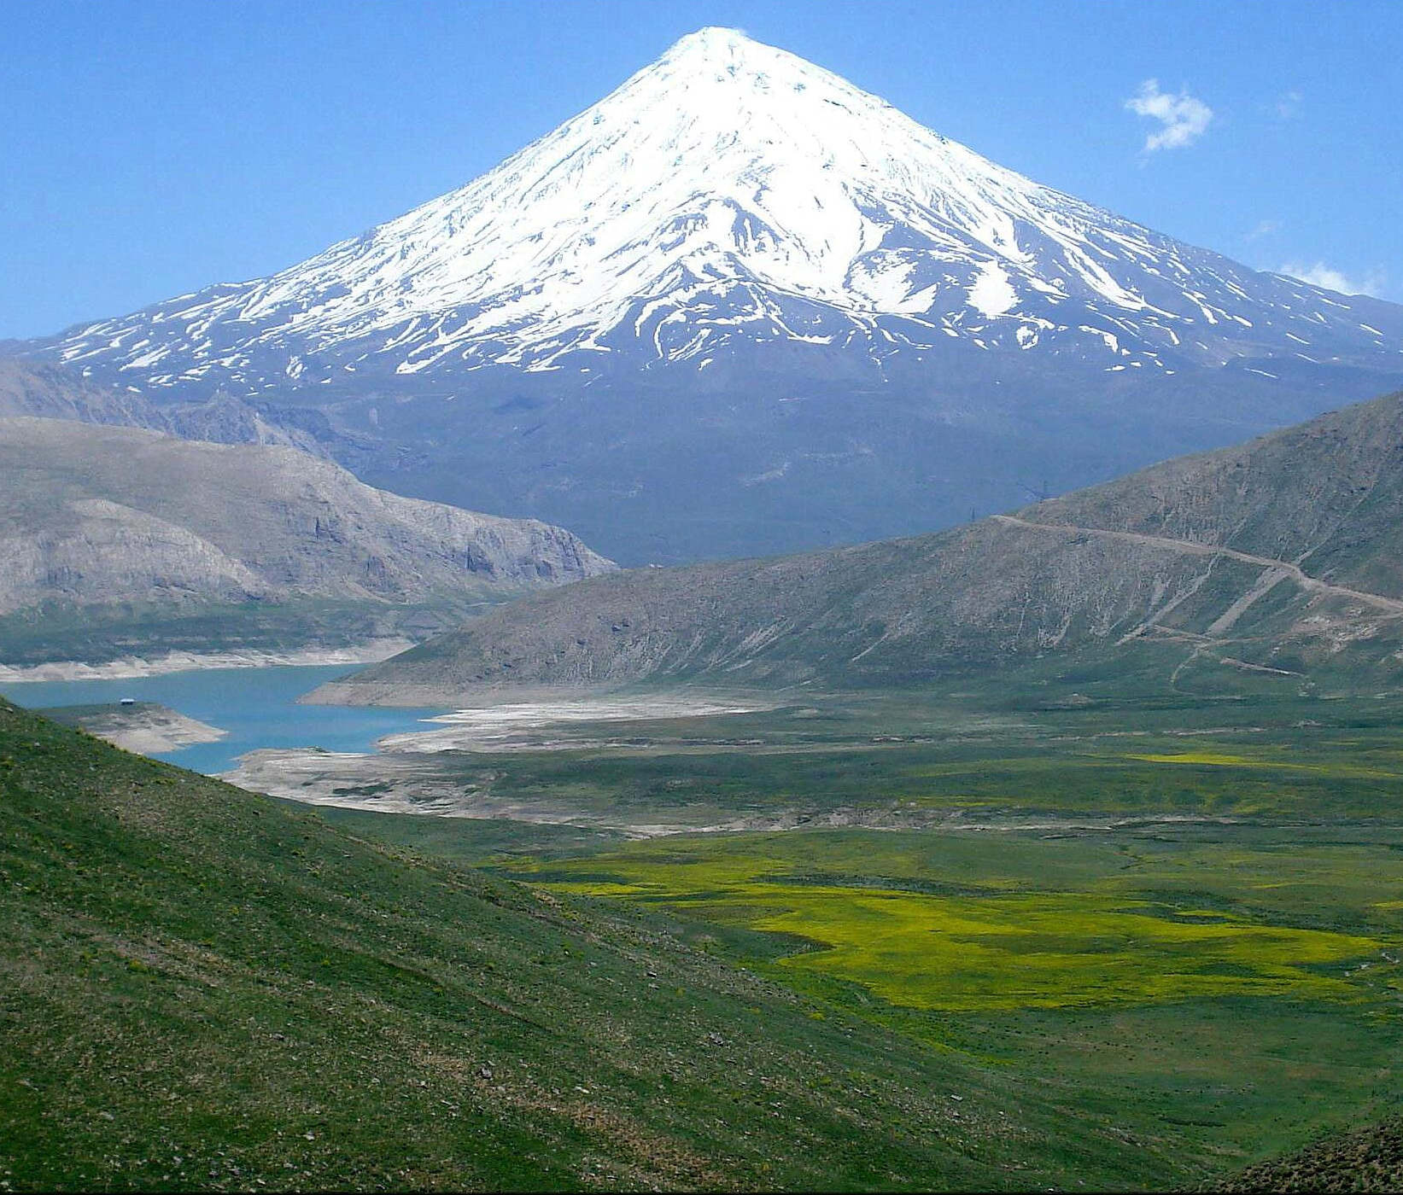
Damavand Mountain, Iran
Thanks For Your Attention

