Slide 1
Detailed review paper on the retinoid system under OECDs program on endocrine disruptors
Helen Håkansson
Karolinska Institutet
Institute of Environmental Medicine (IMM)
helen.hakansson@ki.se

Slide 2
Outline
  OECD Detailed Review Paper 178 on endocrine disruptors (2012)
    Broader scope of endpoints for ED screening and testing
    Retinoid project proposed by Sweden
  Why retinoids? Retinoids in health and disease
  Chemical modulators
  Detailed Review Paper on retinoids
    Content, Time-plan, Management/Financing

Slide 3
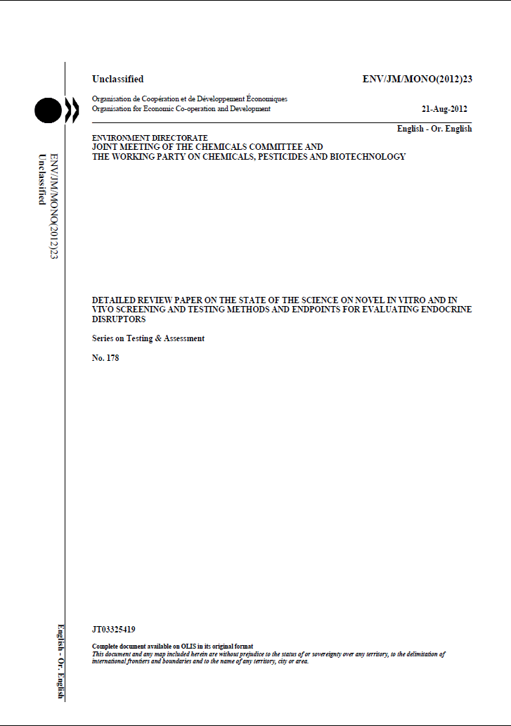
OECD 2012: Detailed Review Paper 178 on EDC testing
DRP178 illustrates the need of ED screening and testing methods/markers beyond EATS and proposes that:
a broader scope of the endocrine and metabolic system is adressed
large scale omics & bioinformatics methodologies are used to clarify AOPs and MOAs
existing TGs are further enhanced and developed with ED end-points, i.e. both EATS and beyond

Slide 4
Background to DRP178: 20 years of knowledge-building has broaden our views on endocrinology and endocrine disruption
Many more hormone receptors in focus
  ER, AR, TR (EAT)
  RXR, PPAR, RAR, LXR, VDR, etc
  CAR, PXR
  AhR, Arnt
In addition, need to consider:
  Hormone synthesis incl many enzyme systems e.g CYPs, UGTs, ROS
  Binding and transport proteins e.g. TTR, RBP, CRABP….
  Membrane receptors e.g. cytokines, growth factors
  Hormonal crosstalk and metabolic modulations on multiple levels……
  Interactions with immune and nervous systems
  Epigenetic modulations

Slide 5
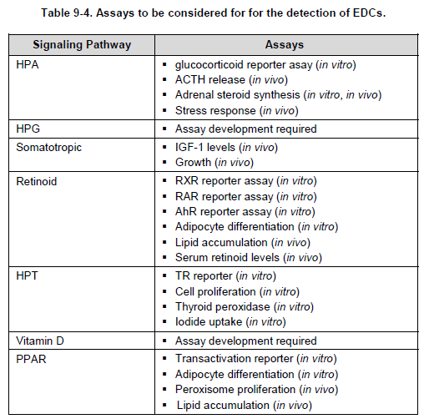
DRP178 proposes projects in several areas:

Slide 6

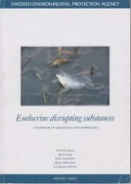
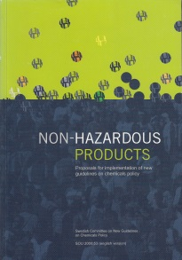
Retinoid project proposed by Sweden in 2014
Builds on priorities in the DRP 178
Aims to identify/support development of methods to:
  Facilitate early screening
  Enhance existing in vivo TGs
  Identify effect biomarkers for population studies
Also builds on previous Swedish authority work on the retinoid system in the ED area of toxicology:
  Sw EPA report on EDCs (1998)
  Sw Gov investigation "Non-hazardous products” (2000)

Slide 7
Proposed project suggests a stepwise way forward
First to develop a Detailed Review Paper (DRP) to get a grip on the role of retinoids in endocrine disruption
Continue with a Retinoid Scoping Effort (RSE) to identify and recommend test methods and markers/end-points
In a next step, consider the retinoid component of PPAR and VDR metabolism/signaling in endocrine disruption
Learn from estrogen and thyroid hormone DRPs and Scoping efforts
Include AOP thinking and practice as possible and useful

Slide 8
Content of the Detailed Review Paper (DRP)
Comprehensive review of the retinoid system. Covering retinoid biology, chemistry, and function in health and disease, as well as retinoids in toxicology and pharmacology.
Stepwise work covering first RAR-RXR, and later move to the hormonal crosstalk with PPAR, VDR, and possibly also TR.
Include published AOP work as a minor part. Expected that, by time, there can be room for devlopment of a whole series of retinoid system-relevant AOPs.

Slide 9





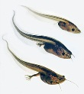
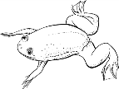
Aim of the Retinoid Scoping Effort (RSE)
To identify and recommend test methods and markers/end-points, which can be used for:
  Early/initial screening of chemical properties as part of a tiered approach
  Enhancement of existing in vivo TGs (e.g. 28 days and EOGRTS)
  Identification and development of effect biomarkers, which can be used for observational studies in humans and wildlife
^{Cells}
^{Non-mammalian}
^{models}
^{Exp mammalian}
^{models}
^{Individuals}
^{Populations}
^{AOPs}
^{Relevance, Plausibility}
^{Exposure - Controlled}
^{Marker/Effect/Outcome}
^{Exposure? Mixtures!!}
^{Disease/Outcome??}

Slide 10
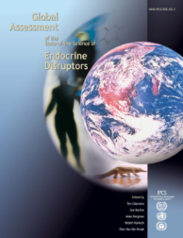
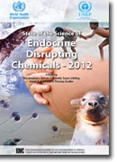
Make project results useful both for Reg Tox and Public Health evaluations
-Identify critical effect/POD for individual EDCs vs identify EDC(s) as risk factors for disease
Regulatory testing
-Experimental studies
e.g. OECDs TGs
-One or more defined
compound at a time
-Mechanistic studies
EDCs
Ca 800 listed
Mixtures
Public Health
-Observational studies
-Mixed exposure
Weight of Evidence
Human relevance & Adversity/Plausibility MOA & AOP/Basic physiology
Metabolism (e.g. ROS, CYP, UGT mm)
Endocrinology (e.g. AhR, NRs)
Cell regulation (what is needed?)
DiseaseRisk
Factors
POD
e.g. ADI
TDI
Notes:
Reach och hormonstörande ämnen utifrån ett regulatoriskt perspektiv; kemikalier på marknaden eller ej och under vilka förutsättningar
Kemikalierna som redan finns i miljön och i våra kroppar, utan att det var tänkt så. Hur bedömer vi dessa exponeringar?
Spelar det någon roll? Behöver vi oroa oss? För egen del? För våra barns del? Här och nu? I framtiden?

Slide 11
AOP development: Which adverse outcomes to adress?
Cardiovascular disease and atRA 637 hits*
Diabetes and atRA 428
Bone disorders and atRA 368
Obesity and atRA 195
Metabolic syndrome and atRA 55
Congenital malformations and atRA 1220
  Heart 164; Craniofacial 195; Eye 103
Cancer and atRA 13668
  Breast 1092; Prostate 364; Ovary 190; Testis 116
* Quick pubmed searches on all-trans Retinoic Acid and public health disease

Slide 12
Proposed project was well received and has been taken on board the OECD work program on new ED end-points
Sweden/KemI (Lead Country)
Netherlands/RIVM
UK/PHE
US/EPA
Finland/THL
Germany/BfR
Spain/UMH
Czech Republic
Italy
Denmark
Norway
France
Japan/NIEHS

Slide 13
Outline
  OECD Detailed Review Paper 178 on endocrine disruptors (2012)
    Broader scope of endpoints for ED screening and testing
    Retinoid project proposed by Sweden
  Why retinoids? Retinoids in health and disease
  Chemical modulators
  Detailed Review Paper on retinoids
    Content, Time-plan, Management/Financing

Slide 14
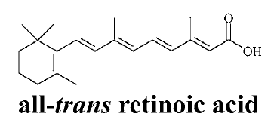
Why Retinoids?
Retinoids are vital molecules, which are essential over the life-course. Nobelprizes: Chemical structure (1937); Visual function (1967);
Homeostatic system with pronounced redundancy on the molecular level i.e. enzymes, binding proteins, receptors, and retinoid forms
Subtle changes in retinoid forms can have direct impact on gene programs that regulate cell differentiation, maturation, and regeneration via several receptor pathways
all-trans-ROH
9-cis-4-oxo-13,14-diyhydro-RA

Slide 15
Particularly important in early development
Retinoid system evolutionary conserved.
Retinoic acid requirement begins at somite stage 4-5. Unless available abnormal development begins and leads to early embryolethality
Gene programs where retinoids are required include:
  Neural tube formation
  Heart looping
  Craniofacial structures
  Sex determination
  Fertilization, spermatogenesis, oogenesis
  Cell differentiation and growth
4/5 somites; RA requirement
0 20 26 29 72h

Slide 16
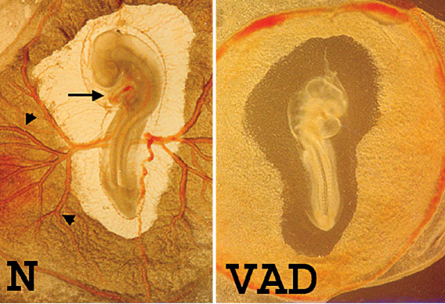
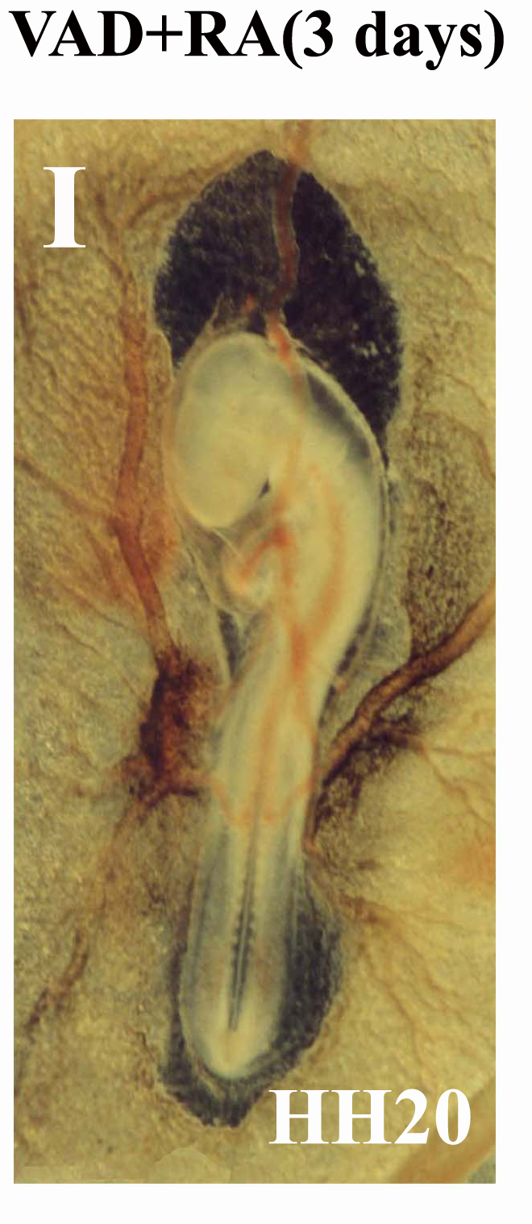
Retinoids and heart looping
(Data from Prof Maija Zile et al, Michigan, US)
atRA is required during a critical time-window for proper heart assymetric alignment (looping), the earliest event in heart morphogenesis. Involves cardiogenic and vascular system cells and processes such as cell division, apoptosis, differentiation, migration, and cell-cell adhesion, i.e. many genes. Several RARs and RXRs are expressed in the heartforming region.

Slide 17
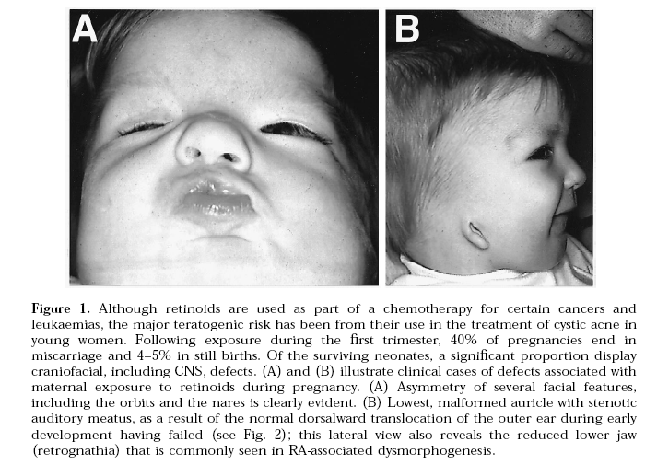
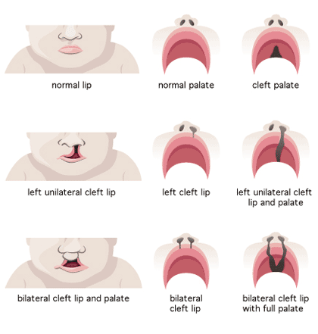
Retinoids and craniofacial malformations
https://www.brennerchildrens.org/images/brenner/image/ial/images/1322/1322_image.gif
Notes:
Retinoic acid and some synthetic retinoids used in the treatment of cystic acne are amongst the most potent human craniofacial teratogens known.

Slide 18
Dietary deficiency and excess are both detrimental
Vitamin A deficiency
Vitamin A excess
Reduced survival
Reduced growth
Impaired development
Impaired function of epithelial tissues
Impaired vision
Impaired fertility
Growth disorders
Teratogenicity
Brittle bones and bone tissue in the wrong places
Fragile epithelial tissues
Changes in vision
Reproductive Disorders

Slide 19
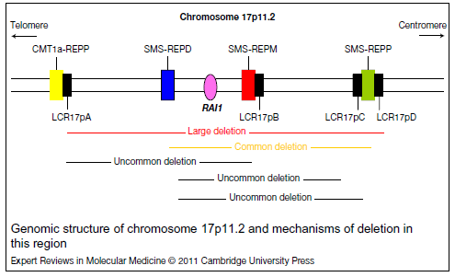
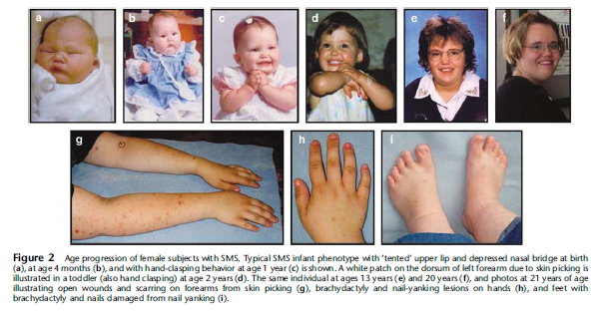
RAI1-related anomalies and delays in development
Smith-Magenis syndrome
- Mutation of RAI1 (atRA induced 1)
Protocki-Lupski syndrome
- Duplication of RAI1 locus
Craniofacial and skeletal abnormalities
Intellectual disability
Self injurous behaviors
Sleep disturbance (retinoids control biol. rythms)
Craniofacial anomalies
Cardiovascular anomalies
Developmental delay
Intellectual disability
Hyperactivity, Autism
(Elsea and Girirajan 2008)
(Elsea and Williams 2011)

Slide 20
Outline
  OECD Detailed Review Paper 178 on endocrine disruptors (2012)
    Broader scope of endpoints for ED screening and testing
    Retinoid project proposed by Sweden
  Why retinoids? Retinoids in health and disease
  Chemical modulators
  Detailed Review Paper on retinoids
    Content, Time-plan, Management/Financing

Slide 21
Chemical modulators
Retinoid homeostasis/signaling are modulated by diverse categories of chemicals
Persistent organic pollutants
  Dioxins, PCBs
  BFRs
  PFAS
Pesticides
Pharmaceuticals
Alcohol
Metals
TBT
BPA
And more…..

Slide 22
Time-course and dose-response for increased levels of atRA following TCDD-exposure

Slide 23
atRA metabolites are affected by dioxin
(Schmidt/Hoegberg et al 2003, Arch. Toxicol. 77:371-383)
Notes:
Some RA metabolites go up, some go down… We concentrated on the major circulating RA metabolite in serum (left) and a new metabolite in liver that has been found to be severely depressed by TCDD. I am speculating that it is a product in the catabolism of 9-cis-RA but we don’t know. This metabolite has also been found in mice and humans.

Slide 24
Retinoid metabolism model
CIRCULATION
CLEARANCE
REOH-RBP-TTR
(in plasma)
Retinyl glucuronides
UGTs
ADHs
RDHs
CRABP-RA
REH
ALDHs, AOX1
CYP 1A1, 1B1
CYP26,
CYP 2B, 3A
Retinyl esters
REOH
RAL
all-trans-RA
OH-/Oxo-RA
LRAT
STORAGE
CRBP-REOH
9c-4o-13,14dh-RA
9-cis-RA
AhR
ARNT
AhRR
THR
CAR
PXR
RXR
NRs
RAR
RXR
SIGNALING AND ACTIVE FORMS
Notes:
Before going into details about the results, it will be useful to place every endpoint at its pertinent position into the retinoid system. Retinyl esters, where retinyl palmitate is included, are the storage forms of the system. These compounds can be converted into retinol, which is transported to target tissues associated to retinol-binding protein (RBP) and then transformed to the active retinoic acid (RA), which, along with other retinoids and derived metabolites – as 9-cis-4-oxo-13,14-dihydro-RA – is essential for many vital processes e.g. embryonic development, metabolism, growth and differentiation of many cell types, haematopoesis, reproduction, vision and bone formation.

Slide 25
Outline
  OECD Detailed Review Paper 178 on endocrine disruptors (2012)
    Broader scope of endpoints for ED screening and testing
    Retinoid project proposed by Sweden
  Why retinoids? Retinoids in health and disease
  Chemical modulators
  Detailed Review Paper on retinoids
    Content, Time-plan, Management/Financing

Slide 26
Retinoid Detailed Review Paper: List of Content
Introduction
  Testing and assessment of endocrine disruptors: the OECD 2012 strategy:
  Idea behind OECD 2012
  Conclusions OECD DRP 2012
  Overview
The Retinoid system
  The retinoid receptors
  Retinoid transport and metabolism
  Retinoid function
  Retinoid related diseases*
  Retinoid related anomalies/malformations*
  *which ones? Narrative approach & physiology experts?
Notes:
Possible explanation for differently sensitive CYP2B induction in males and females: Different levels of CAR in male and female hepatocytes (YOSHINARI et al., 2000, higher levels of CAR in males in Wistar Kyoto Rats)
Disruption of RBP-TTR may occur via a OH-metabolite, just like for PCBs. Why only in males? Metabolite formed only or primarily in males.

Slide 27
Retinoid Detailed Review Paper cont..
Chemicals affecting the Retinoid system
  Dioxins, PCBs, Brominated flame retardants, PFAS
  Conazoles, Organochlorine pesticides, mfl
  Ethanol (incl Fetal alcohol syndrome)
  Retinoid drugs incl CYP26 and RALDH2 inhibitors
  RAR agonists and RAR antagonists
  Chemical mixtures
Approaches for testing retinoid system toxicity (Scooping effort)
Conclusions and scope of a project establishing retinoid system toxicity testing
To be completed
Notes:
Possible explanation for differently sensitive CYP2B induction in males and females: Different levels of CAR in male and female hepatocytes (YOSHINARI et al., 2000, higher levels of CAR in males in Wistar Kyoto Rats)
Disruption of RBP-TTR may occur via a OH-metabolite, just like for PCBs. Why only in males? Metabolite formed only or primarily in males.

Slide 28
Time-plan (First revised)
    2015/16-2018: Retinoid DRP (RAR-RXR)
      First preliminary draft developed over a 6 month period to be used as a starting material for a workshop/working meeting during 2016.
    2017-2019: Retinoid Scoping Effort (RSE)
    2017-2019: Minor AOP efforts related to the retinoid system
    No timeplanning yet for work on VDR or PPAR

Slide 29
Managment/Financing, Working process
In kind and external resources needed for planning, draftings and meetings
  OECD Secretariate; Swedish secretariate – Kemi/IMM
  Nordic working group – NordUtte
  International scientific lead of DRP development – under establishment
  DRP Chapter responsibilities – under establishment
Several scientific open workshops – in planning
F2F and TC meetings – in planning
Need of experts both in physiology/public health and in toxicology/pharmacology. Thus a broad collaboration among member states and different categories of stakeholders will be needed from academia, regulatory agencies, and industry. Broad expertise and anchoring needed in the DRP development and/or workshop discussions.
Notes:
Possible explanation for differently sensitive CYP2B induction in males and females: Different levels of CAR in male and female hepatocytes (YOSHINARI et al., 2000, higher levels of CAR in males in Wistar Kyoto Rats)
Disruption of RBP-TTR may occur via a OH-metabolite, just like for PCBs. Why only in males? Metabolite formed only or primarily in males.

Slide 30
Thank you!
Need and room for data!
Need and room for competence!
Take contact!
  helen.hakansson@ki.se
  yvonne.andersson@kemi.se

