Slide 1
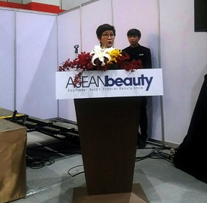
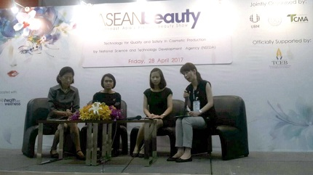
Quality and Safety in cosmetic production
28/04/2017
Kudos to the organizers of ASEANbeauty who have decided to include a panel discussion on “Technology for Quality and Safety in Cosmetic Production”. The decision is very appropriate as consumers and manufacturers need to be aware of the various chemicals that are being used to produce cosmetics and personal care products and the possible harm these chemicals can have on humans. Dr. Sasitorn Aueviriyavit a researcher from NANOTEC Safety and Risk Assessment Lab (SRA) was one of the panellist invited to talk about the roles of NANOTEC on quality and safety evaluation of cosmetic products by sharing information on alternative testing methods, and evaluation of the anti-microbial protection of cosmetic products.
ASEANbeauty is the premier international beauty trade show for Southeast Asia and is being held from 27-29 April 2017 at Bangkok International Trade & Exhibition Centre (BITEC).
To unsubscribe by email

